Slide 1
AI-Systems Machine Learning in the Cloud
Joseph E. Gonzalez
Co-director of the RISE Lab jegonzal@cs.berkeley.edu

Slide 2
What is cloud computing?

Slide 3
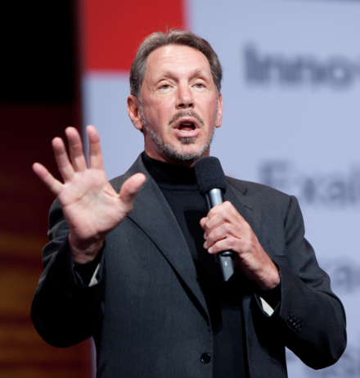
“The interesting thing about Cloud Computing is that we’ve redefined Cloud Computing to include everything that we already do. . . . I don’t understand what we would do differently in the light of Cloud Computing other than change the wording of some of our ads.”
-- Larry Ellison, Wall Street Journal, 2008
Quote from “Above the Clouds: A Berkeley View of Cloud Computing”

Slide 4

8 years later …
2016

Slide 5
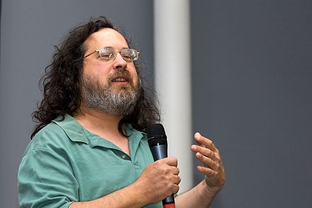
“If ‘cloud computing’ has a meaning, it is not a way of doing computing, but rather a way of thinking about computing: a devil-may-care approach which says, ‘Don't ask questions. Don't worry about who controls your computing or who holds your data. Don't check for a hook hidden inside our service before you swallow it. Trust companies without hesitation.’ In other words, ‘Be a sucker.’ ”
-- Richard Stallman, Boston Review, 2010
https://bostonreview.net/articles/richard-stallman-free-software-drm/

Slide 6
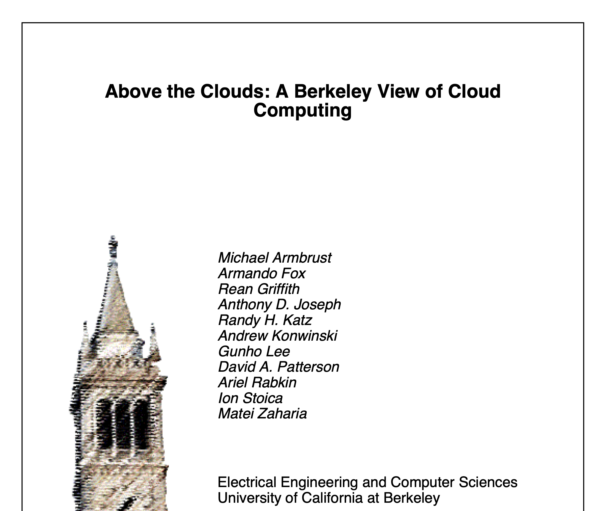
2006-2011
Early paper on cloud computing and helped drive excitement in the field.
Published in 2009 and received over
8,4000 citations
Made the case for cloud computing
Illusion of infinite resources
Elimination of up-front costs
Pay-per-use
Economies of scale for everyone
Simplified operations
Higher hardware utilization

Slide 7
Defining Characteristics of the Cloud
The illusion of infinite computing resources available on demand
The elimination of an up-front commitment by users
The ability to pay for use of computing resources on a short-term basis as needed
→ Essentially Utility Computing
Public Cloud: when these services are available to the general public
Private Cloud: when these services are sold within a business
Quote from “Above the Clouds: A Berkeley View of Cloud Computing”

Slide 8
The Beginning of the Cloud
1961: John McCarthy presents idea of Utility Computing
2006: Amazon Web Services (AWS) Launched
2008: Google Cloud Launched
2008: Azure Cloud Launched
2009: Berkeley writes: “Above the Clouds: A Berkeley View of Cloud Computing”

Slide 9
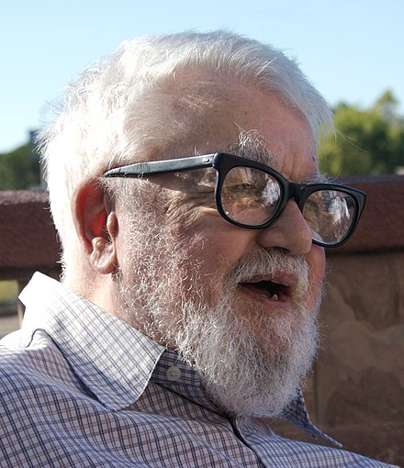
Utility Computing is an old idea
“If computers of the kind I have advocated become the computers of the future, then computing may someday be organized as a public utility just as the telephone system is a public utility... The computer utility could become the basis of a new and important industry.” – John McCarthy
Public Cloud (>$300B)
Early Pioneer in Artificial Intelligence
Turing award for contributions to AI

Slide 10
Why did it take until 2006?
Change is business models for computing
Web2.0 – low commitment, self-serve, pay-as-you-go -- not enough capital to own equipment.
Existing big-tech companies were aggressively exploiting economies of scale to drive down costs
Renting becomes cheaper than buying machines
New workloads emerged to leverage elasticity:
Web applications needed to handle demand surges
Data intensive apps leveraged scale -- fast is cheap

Slide 11
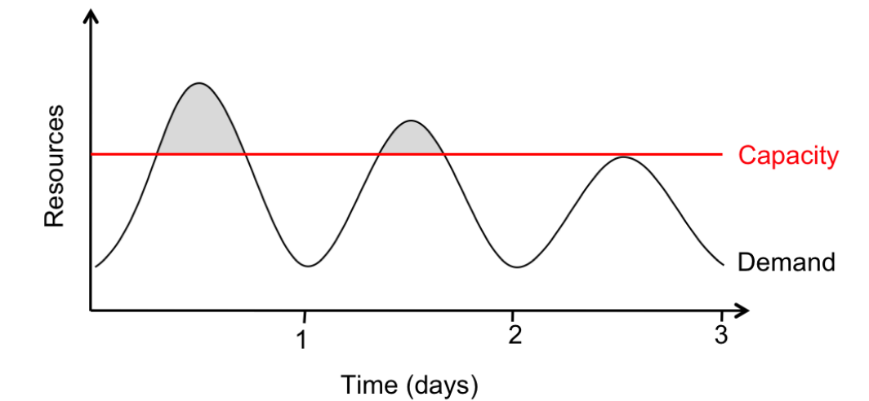
Economics of the Cloud
CapEx to OpEx: transition from large up-front capital expenditures to operational expenditures
More money to spend on your launching your business
Improved Utilization through statistical multiplexing
real-world server utilization for a single business ~ 5% to 20%.
Economies of scales
Negotiate lower hardware prices
Spread management costs
Leverage existing investments

Slide 12
The Cloud Enabled Academic Research
Access to the latest hardware
Ability to burst experiments near conference deadlines
Usually…
Ability for students to build and evaluate large-scale systems
I would frequently run concurrent experiments with hundreds of machines each!
industrial adoption
Companies can evaluate open-source (academic) big data tools without big upfront investment in hardware.

Slide 13
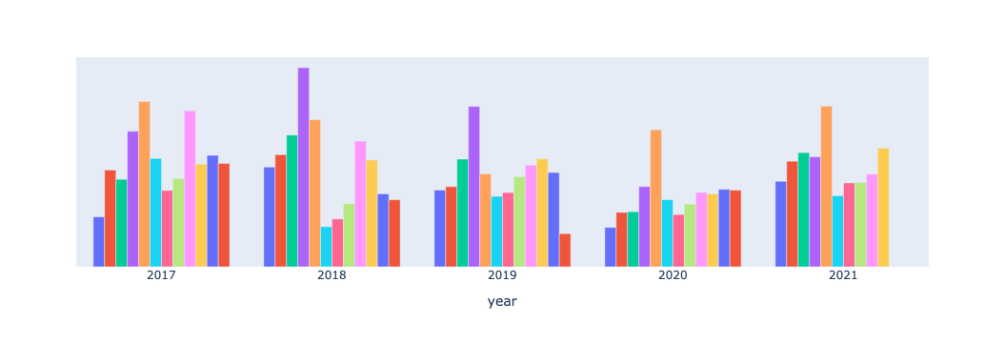
What about the Cloud?
Access to latest GPUs and TPUs drove AI research
used a LOT OF CREDITS (thank you AWS, Azure, & Google!)
Conference Deadlines
We only had to “pay” for this region.
Y-axis scales are hidden because they are embarrassing

Slide 14
The Elasticity of the cloud drove us to rethink our approach to AI Research

Slide 15
Deadline
Accuracy
Time
Notes:
At the core of all machine learning is the curve of a models accuracy over training time. Read through any ML paper today and you will probably see a curve like this or an accuracy number which is simply the accuracy attained by the time the authors needed to publish their results. This is a very limited view of the model training process however, so let’s zoom out to see what this process looks like over the weeks before this conference or production deadline. Each of the lines in this graph represent a model with a different hyperparameter configuration, where a hyperparameter is any parameter that can affect the models training, and you can see that there is a surge of trial hyperparameters training very close to the deadline in order to obtain a model with the highest possible accuracy. This process is hyperparameter tuning and it is the most compute intensive part of the model development process. Since the space of possible hyperparameters is incredibly large and it takes a lot of compute to train even one model to convergence, developers will launch a subset of possible configurations, stopping some of these trials early if they do not look promising in order to reallocate those compute resources. The choice of hyperparameter has a drastic affect on final accuracy so its very important to find and train the optimal or close to optimal trial depected here in red.
It is this deadline focused hyperparameter tuning that we are interested in for this talk. More specifically, how can we sufficiently explore the space of possible configurations to find a good trial and train it so that we can return a highly accuracte model given a fixed deadline and resource constraints.

Slide 16
Deadline
Accuracy
Time

Slide 17
Deadline
Accuracy
Time

Slide 18
Exploration
Exploitation
00:00
Time (mins)
60:00
00:00
Time (mins)
45:00
GPU 1
GPU 1
GPU 2
GPU 2
Model learning rate 𝒍, weight decay d
GPU 3
GPU 3
GPU 4
GPU 4
GPU 5
GPU 5
GPU 6
GPU 6
GPU 7
GPU 7
GPU 8
GPU 8
Notes:
Hyperparameter tuning is a necessary but often dreaded step in the machine learning pipeline.
Every model contains parameters that need to be set in training, for example learning rate or weight decay, that can drastically affect the learning process and thus the final accuracy. For example this graph shows the accuracy curves during training of a vision model set with different hyperparameter configurations. As you can see, the final accuracies are all over the place, and this effect is seen across almost all models and datasets.
While this may

Slide 19
Linear Scaling
Exploitation
00:00
Time (mins)
45:00
GPU 1
GPU 2
GPU 3
GPU 4
GPU 5
GPU 6
GPU 7
GPU 8
Notes:
Explain sub linear parallelism

Slide 20
Linear Scaling
Exploitation
00:00
Time (mins)
45:00
GPU 1
GPU 2
GPU 3
GPU 4
GPU 5
GPU 6
GPU 7
GPU 8
Notes:
Explain sub linear parallelism

Slide 21
Fixed Cluster
Cloud
Resources = Machines
Resources = Money
Notes:
Explain the concept of resrouce time

Slide 22
Fixed Cluster
Cloud
Resources = Machines
Resources = Money
GPU-mins
GPU-mins
start
Time
deadline
Notes:
Explain the concept of resrouce time

Slide 23
Fixed Cluster
Cloud
Resources = Machines
Resources = Money
GPU-mins
GPU-mins
Less Parallel
Exploitation
More parallel exploration
start
Time
deadline
start
Time
deadline
Notes:
Explain the concept of resrouce time

Slide 24
00:00
Time (mins)
Deadline
GPU 1
GPU 2
GPU 3
GPU 4
Liaw et al.
Notes:
Motivate traingles from squares

Slide 25
00:00
Time (mins)
Deadline
GPU 1
GPU 2
GPU 3
GPU 4
GPU 5
Notes:
Motivate traingles from squares

Slide 26
00:00
Time (mins)
Deadline
GPU 1
GPU 2
GPU 3
GPU 4
GPU 5
Notes:
Motivate traingles from squares

Slide 27
00:00
Time (mins)
Deadline
GPU 1
GPU 2
GPU 3
GPU 4
GPU 5
GPU 6
Notes:
Motivate traingles from squares

Slide 28
00:00
Time (mins)
Deadline
GPU 1
GPU 2
GPU 3
GPU 4
GPU 5
GPU 6
Notes:
Motivate traingles from squares

Slide 29
00:00
Time (mins)
Deadline
GPU 1
GPU 2
GPU 3
GPU 4
GPU 5
GPU 6
Notes:
Motivate traingles from squares

Slide 30
When it comes to machine-time allocation
00:00
Time (mins)
Deadline
00:00
Time (mins)
Deadline
GPU 1
GPU 1
GPU 2
GPU 2
GPU 3
GPU 3
GPU 4
GPU 4
GPU 5
GPU 6
Triangles > Rectangles
Notes:
Motivate traingles from squares

Slide 31
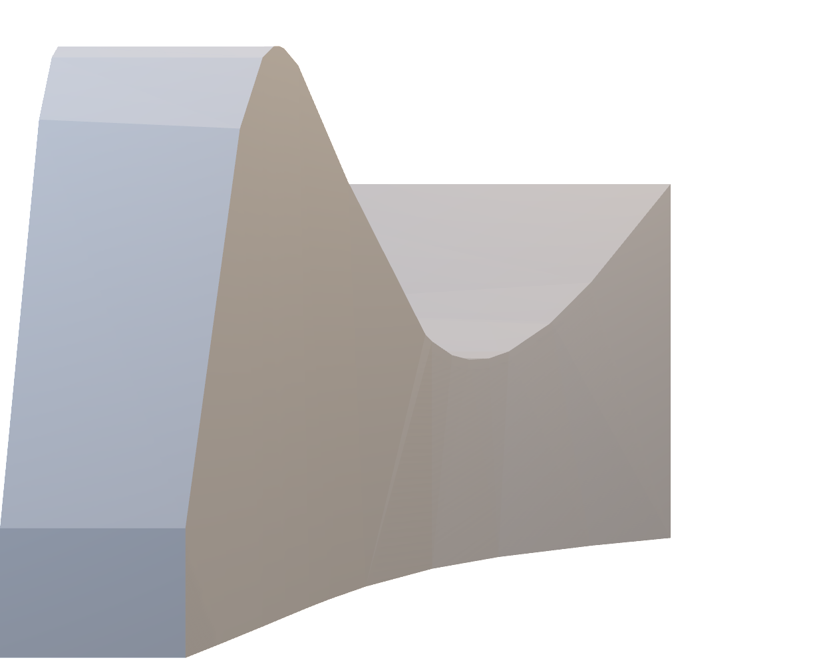
Think outside the box
Compute
Cloud Computing
Cluster
Computing
Compute
Time
Time
Storage
Storage
Cloud computing → Infinite resources with a finite budget (volume constraints).

Slide 32
The cloud as a utility
Cloud Computing
Compute
Time
Storage
“Serverless”

Slide 33




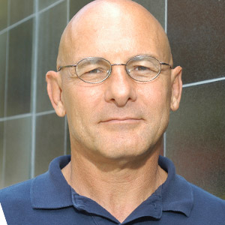
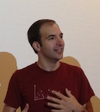







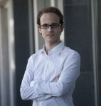




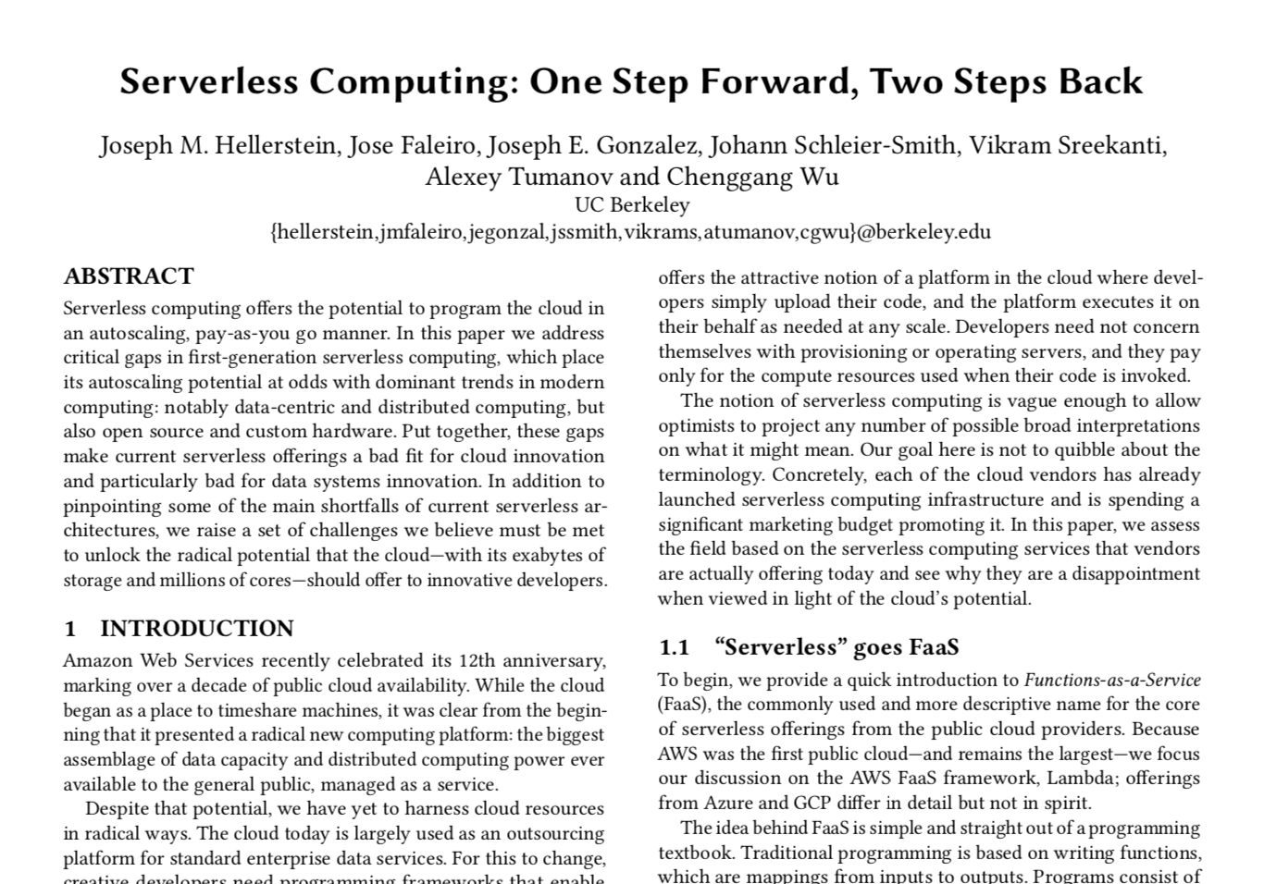
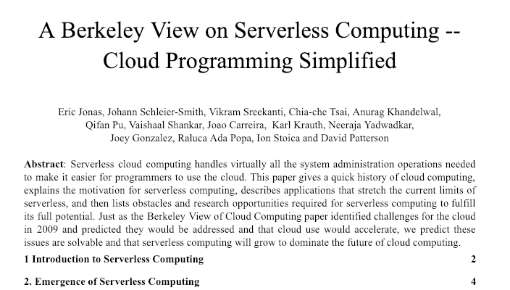
Notes:
Johann
Started with you

Slide 34
Canonical example

Slide 35
Canonical example
BaaS
FaaS
BaaS
BaaS

Slide 36
AWS Lambda
Introduced Function as a Service (FaaS)
Autoscaling done right
Highly elastic - adapts quickly
Scales down to zero
Fine-grained 100 ms billing increment
Cloud provider shares risk and responsibility for utilization
Strong isolation allowing multi-tenant multiplexing
Benefits from scale of Amazon’s platform & ecosystem of APIs
Notes:
Johann
App Engine launched earlier, very similar, some key differences

Slide 37
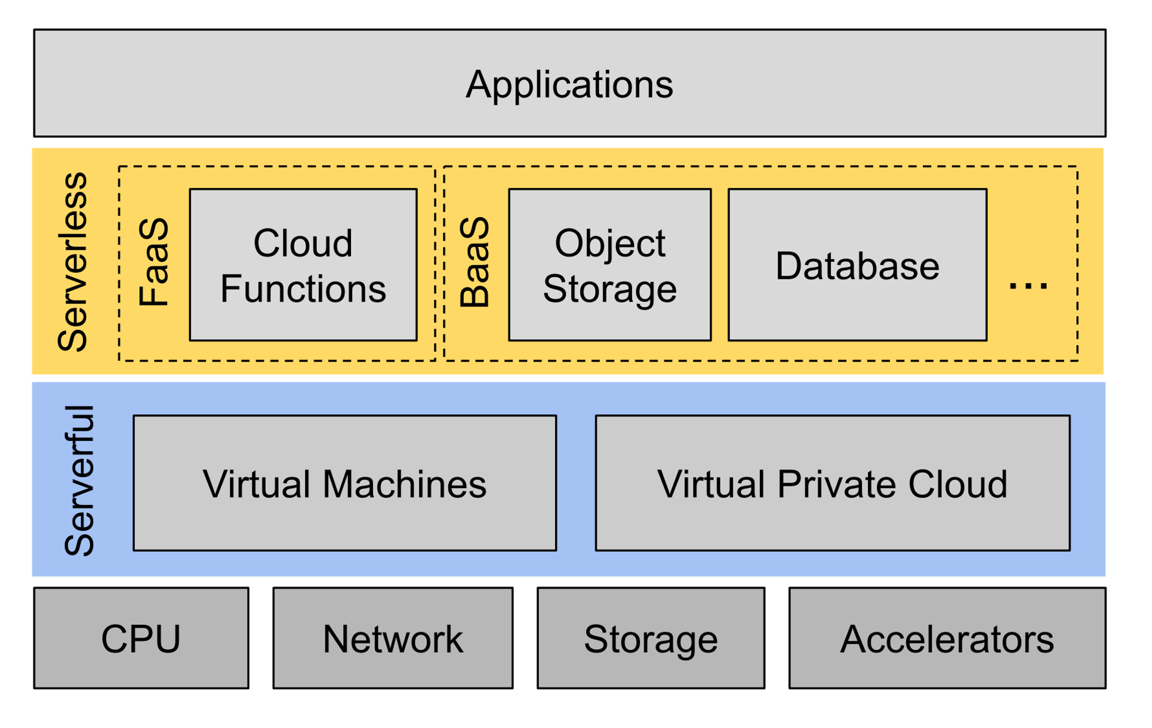
A Layer to Simplify Using the Cloud
Notes:
TODO animate this slide, add example TcaplusDB

Slide 38
Three essential qualities of serverless computing
‌Hides servers and the complexity of programming and operating them
Offers a pay-per-use cost model with no charge for idle resources
Has excellent autoscaling so resources match demand closely

Slide 39
Airport Analogy
When you arrive at the destination airport and need to get to your hotel you could:
Buy a car and drive [Legacy on premise systems]
Long term investment and you are responsible for everything
Rent a car and drive [Serverfull]
You are still responsible for fuel, parking, insurance, …
Take an Uber. [Serverless]
You are paying only for the transportation you need

Slide 40
Serverless Next Phase of Cloud Programming
Phase 1: Simplified System Administration
Use an API to get servers instead of building out a data center
Developers take responsibility for managing virtual machines
Pay for bundles of hardware at coarse granularity
Cloud provider takes responsibility for physical infrastructure
Phase II: Simplified Programming
Write applications and not infrastructure and run them at any scale
Fine grained billing of consumed resources and services
Cloud provider assumes responsibility for all aspect of system operation

Slide 41
Open Research Challenges
Efficient serverless computing requires disaggregation of storage and compute but this often adds overhead
Cloud needs to estimate and forecast workload requirements and then price latency and availability.
Need mechanisms for fine-grained multitenancy and strong isolation
Unclear how to deal with specialized hardware
Does user request hardware or bid a premium on speed?

Slide 42
Where is the cloud headed?

Slide 43
With each phase of the cloud (and computing), we raised the abstraction.
This continuous process of simplification enables concurrent innovation on both sides of the boundary.
It also improves portability and transforms the market.
Notes:
TODO animate this slide, add example TcaplusDB

Slide 44

Sky Computing

Slide 45






Sky Example
ML Pipeline
Data proc
Training
Serving
Sky
Secure Data proc
Training
Serving
Use Azure Confidential Computing for secure data processing
Use Google Cloud for training on TPUs (fastest and cheapest)
Use AWS for serving on Inferentia (cheapest)

Slide 46
Conjectures for the Future
We will continue to race towards utility-oriented computing
Pay for consumption and not capacity
Higher levels of abstraction will
Reduce operational complexity (burden shifts to the cloud + ML)
Drive more rapid innovation in cloud hardware
Enable applications to more easily span multiple clouds
Sky computing is the inevitable future of computing

Slide 47
Readings This Week

Slide 48
Pollux: Co-adaptive Cluster Scheduling for Goodput-Optimized Deep Learning
Published in OSDI’21 – Best Paper Award
Why we chose it?
Good example of work exploring scheduling of for ML
Addresses ML and Systems concerns: throughput, improvements in accuracy, fairness?
Things to think about:
Implications for elasticity?
What about hyperparameter search?

Slide 49
The Sky Above the Clouds [Unpublished]
Draft of the vision paper describing Sky research agenda
Do Not Distribute
Feedback will help the paper (be critical!)
Makes a case for both the inevitability and need for research in “Sky Computing”
Things to think about:
Presentation of premise [what is proposed?]
Role of data
Role of research
ML Systems Research Case?

Slide 50
FrugalML: How to Use ML Prediction APIs More Accurately and Cheaply
Published in NuerIPS’20
Example of a “Sky Computing” ML research direction
Combining competing prediction services to improve accuracy and reduce costs.
Potentially exciting new research direction!
Things to think about:
Latency
Out-of-domain performance
Uncertainty calibration and model biases
Mathematical presentations

